Slide 1
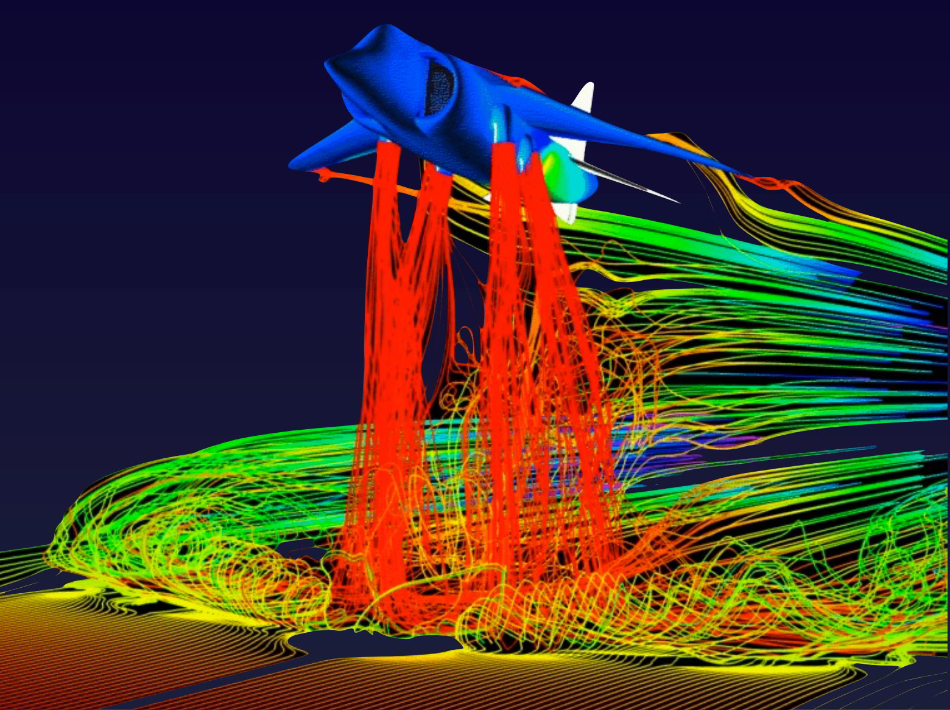
PHYS 8750 Numerical Fluid Dynamics
Fall, 2020
Jet flow visualization Cristoph Garth Institute for Data Analysis and Visualization – UC Davis

Slide 2
PHYS 8750
Outline
2D-Problems (x and y)
Discrete-dispersion method
Stability condition
Difference with 1-D problems
Directionality in 2D advection
Using upstream scheme
Corner Transport Upstream (CTU)
Lax-Wendroff + CTU
Examples (Codes)
Class #12 (Chapter 4.1)
Staggered grids in time and space
Class #13 (Chapter 4.2)
1) PDE with two variables
2) Lax-Wendroff + CTU

Slide 3
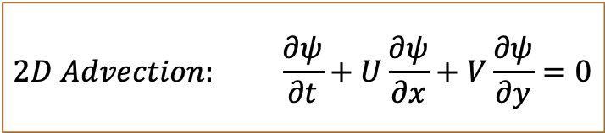
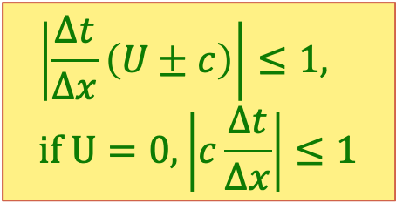
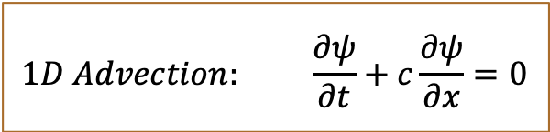
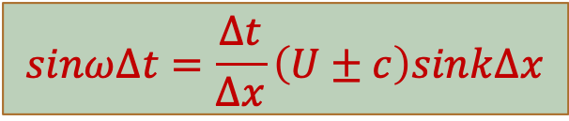
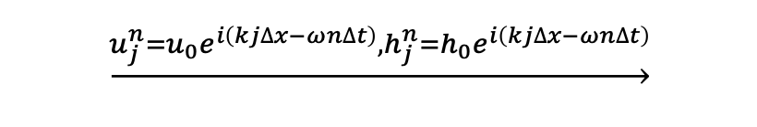
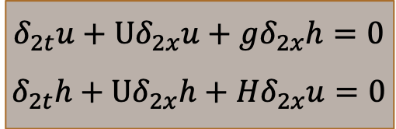
2D Advection Problem
$$1D Advection: \frac{∂ψ}{∂t}+c\frac{∂ψ}{∂x}=0$$
$$2D Advection: \frac{∂ψ}{∂t}+U\frac{∂ψ}{∂x}+V\frac{∂ψ}{∂y}=0$$
Discrete-dispersion Relation to evaluate stability of various schemes
Leapfrog/Center space
$$δ_{2t}u+Uδ_{2x}u+gδ_{2x}h=0$$
$$δ_{2t}h+Uδ_{2x}h+Hδ_{2x}u=0$$
$$\underset{→}{u_{j}^{n}=u_{0}e^{i\left(kj∆x−ωn∆t\right)},h_{j}^{n}=h_{0}e^{i\left(kj∆x−ωn∆t\right)}}$$
$$\left|\frac{∆t}{∆x}\left(U±c\right)\right|≤1, if U=0,\left|c\frac{∆t}{∆x}\right|≤1$$
$$sinω∆t=\frac{∆t}{∆x}\left(U±c\right)sink∆x$$

Slide 4
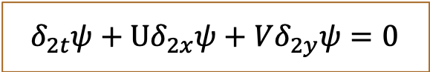
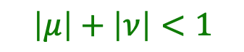
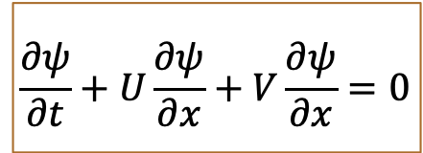
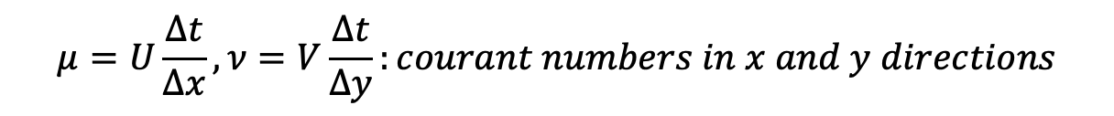
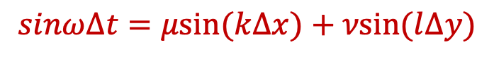
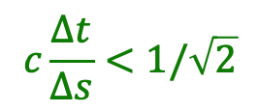
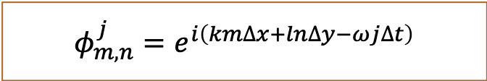
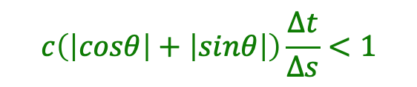
Discrete-Dispersion Relation
$$\frac{∂ψ}{∂t}+U\frac{∂ψ}{∂x}+V\frac{∂ψ}{∂x}=0$$
leapfrog
$$δ_{2t}ψ+Uδ_{2x}ψ+Vδ_{2y}ψ=0$$
Center space
$$φ_{m,n}^{j}=e^{i\left(km∆x+ln∆y−ωj∆t\right)}$$
discrete-dispersion relation:
$$sinω∆t=μsin⁡(k∆x)+νsin⁡(l∆y)$$
$$\left|μ\right|+\left|ν\right|<1$$
$$μ=U\frac{∆t}{∆x},ν=V\frac{∆t}{∆y}:courant numbers in x and y directions$$
$U=c×cosθ, V=c×sinθ, and suppose ∆x$= $∆y$ $=∆s$
$$c\left(\left|cosθ\right|+\left|sinθ\right|\right)\frac{∆t}{∆s}<1$$
$$c\frac{∆t}{∆s}<1/\sqrt{2}$$

Slide 5
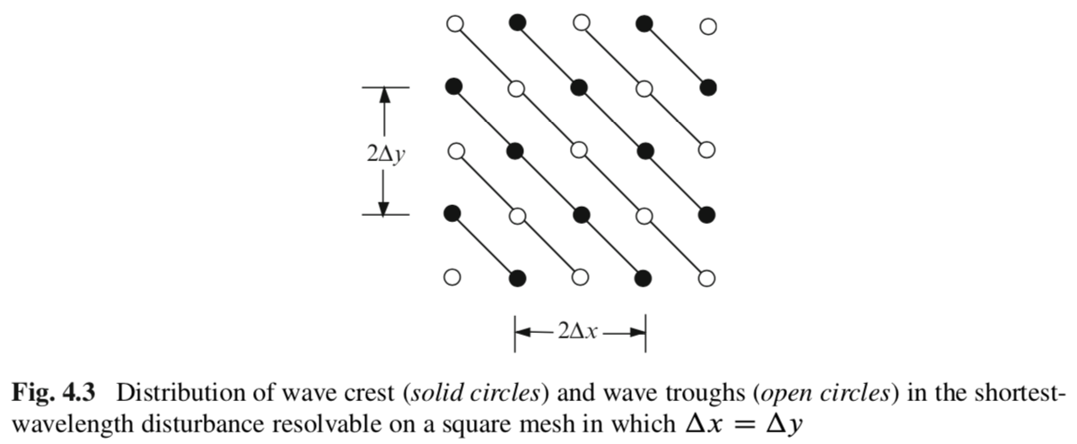
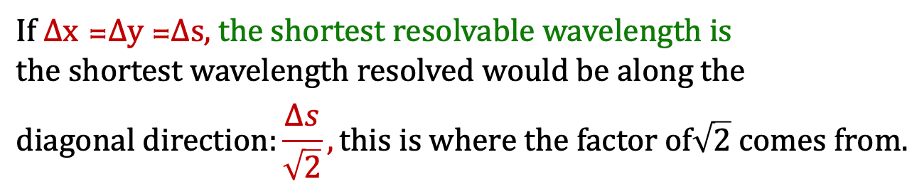
Stability Criterion: From 1D to 2D
Durran’s book
$If ∆x$ =$∆y$=$∆s,$ the shortest resolvable wavelength is $the shortest wavelength resolved would be along the$
$$diagonal direction:\frac{∆s}{\sqrt{2}}, this is where the factor of\sqrt{2} comes from.$$

Slide 6
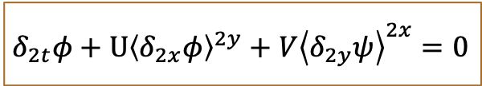
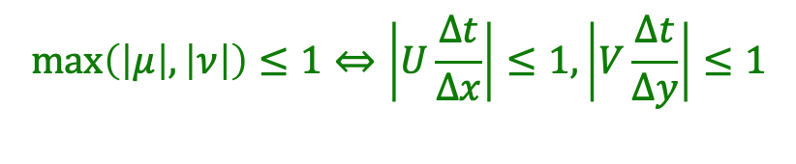
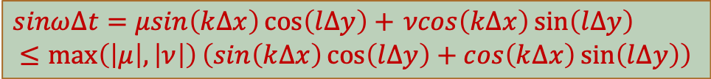
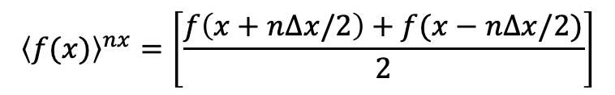
Average Scheme
Way to loosen the constraint: take average of the spatial derivative
$$δ_{2t}φ+U{\left\langle δ_{2x}φ\right\rangle }^{2y}+V{\left\langle δ_{2y}ψ\right\rangle }^{2x}=0$$
$${\left\langle f(x)\right\rangle }^{nx}=\left[\frac{f\left(x+n∆x/2\right)+f(x−n∆x/2)}{2}\right]$$
Discrete-dispersion relation:
$sinω∆t=μsin\left(k∆x\right)\cos\left(l∆y\right)+$ $νcos\left(k∆x\right)\sin\left(l∆y\right)$
$$≤\max\left(\left|μ\right|,\left|ν\right|\right)\left(sin\left(k∆x\right)\cos\left(l∆y\right)+cos\left(k∆x\right)\sin\left(l∆y\right)\right)$$
Stability criterion:
$$\max\left(\left|μ\right|,\left|ν\right|\right)≤1⇔\left|U\frac{∆t}{∆x}\right|≤1, \left|V\frac{∆t}{∆y}\right|≤1$$
$U=c×cosθ, V=c×sinθ, and suppose ∆x$= $∆y$ $=∆s$
$c\frac{∆t}{∆s}<\frac{1}{\sqrt{2}}, \frac{U}{cosθ}\frac{∆t}{∆s}<1/\sqrt{2}$, $U \frac{∆t}{∆s}=U \frac{∆t}{∆x}<cosθ/\sqrt{2}$

Slide 7
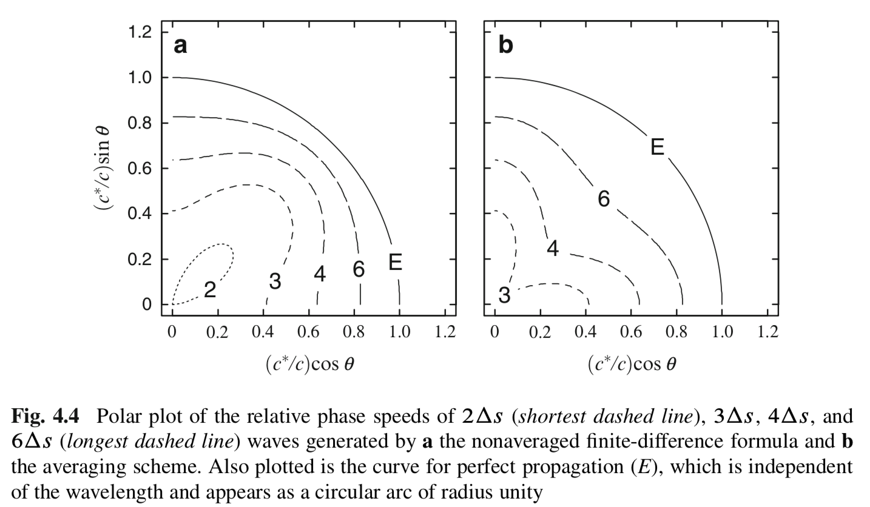
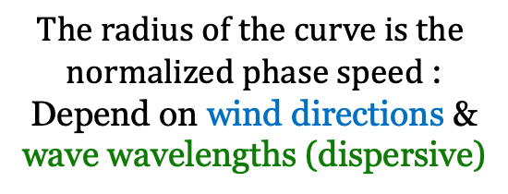
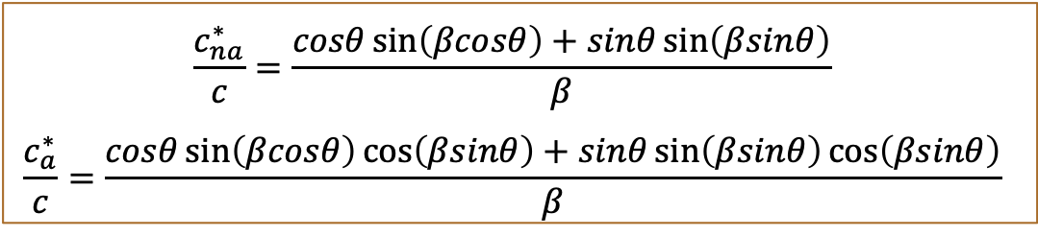


Phase Speed Behaviors
$$The radius of the curve is the$$
$normalized phase speed$:
Depend on wind directions & wave wavelengths (dispersive)
$$θ$$
$$θ$$
$$\frac{c_{na}^{∗}}{c}=\frac{cosθ\sin\left(βcosθ\right)+sinθ\sin\left(βsinθ\right)}{β}$$
$$\frac{c_{a}^{∗}}{c}=\frac{cosθ\sin\left(βcosθ\right)\cos\left(βsinθ\right)+sinθ\sin\left(βsinθ\right)\cos\left(βsinθ\right)}{β}$$
$U=c×cosθ, V=c×sinθ,θ$ is the angle of mean wind
$$β=K∆s, K is magnitude of wavenumber$$

Slide 8
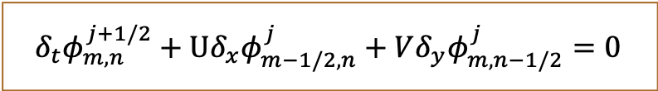
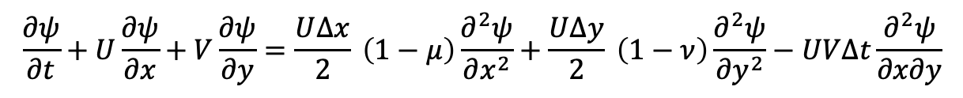
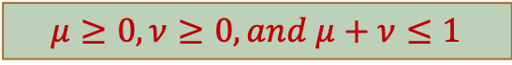
Forward-in-time Schemes
Forward-in-time and upstream scheme:
$$δ_{t}φ_{m,n}^{j+1/2}+U{δ_{x}φ}_{m−1/2,n}^{j}+V{δ_{y}φ}_{m,n−1/2}^{j}=0$$
Stability criterion:
$$μ≥0,ν≥0,and μ+ν≤1$$
Taylor expansion, the truncation error is:
$$\frac{∂ψ}{∂t}+U\frac{∂ψ}{∂x}+V\frac{∂ψ}{∂y}=\frac{U∆x}{2} \left(1−μ\right)\frac{∂^{2}ψ}{∂x^{2}}+\frac{U∆y}{2} \left(1−ν\right)\frac{∂^{2}ψ}{∂y^{2}}−UV∆t\frac{∂^{2}ψ}{∂x∂y}$$
The coefficient$−UV\frac{∂^{2}ψ}{∂x∂y}$ on $∆t$ error term has directional preference
$if we write r=x+y, s=x−y, then \frac{∂ψ}{∂t}=−\frac{∂^{2}ψ}{∂x∂y}$ = $\frac{∂^{2}ψ}{∂s^{2}}−\frac{∂^{2}ψ}{∂r^{2}}$
“Diffusive” along r and “antidiffusive” along s, which tends to distort solution, elongated in one direction, and shortening in the other.

Slide 9
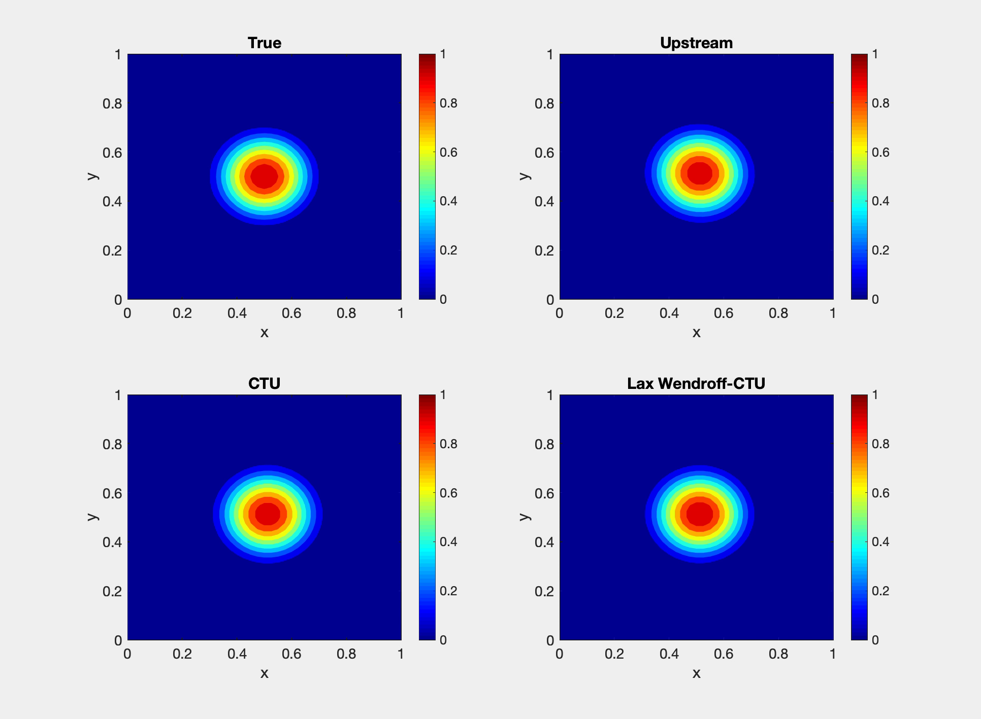
Problem of 2-D Upstream Scheme

Slide 10
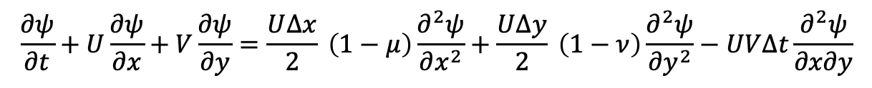
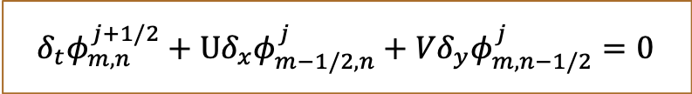
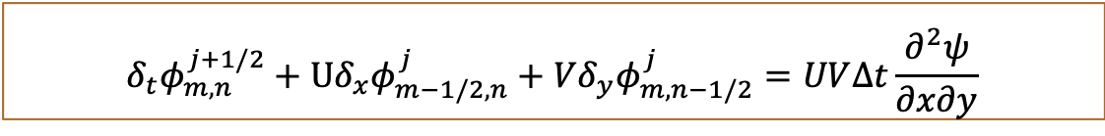
Corner Transport Upstream (CTU) Method
Truncation error after Taylor expansion:
$$\frac{∂ψ}{∂t}+U\frac{∂ψ}{∂x}+V\frac{∂ψ}{∂y}=\frac{U∆x}{2} \left(1−μ\right)\frac{∂^{2}ψ}{∂x^{2}}+\frac{U∆y}{2} \left(1−ν\right)\frac{∂^{2}ψ}{∂y^{2}}−UV∆t\frac{∂^{2}ψ}{∂x∂y}$$
Forward-in-time and upstream scheme:
$$δ_{t}φ_{m,n}^{j+1/2}+U{δ_{x}φ}_{m−1/2,n}^{j}+V{δ_{y}φ}_{m,n−1/2}^{j}=0$$
Modification
$$δ_{t}φ_{m,n}^{j+1/2}+U{δ_{x}φ}_{m−1/2,n}^{j}+V{δ_{y}φ}_{m,n−1/2}^{j}=UV∆t\frac{∂^{2}ψ}{∂x∂y}$$
Corner Transport Upstream (CTU) method
$$δ_{t}φ_{m,n}^{j+1/2}+U{δ_{x}φ}_{m−1/2,n}^{j}+V{δ_{y}φ}_{m,n−1/2}^{j}=UV{δ_{x}δ_{y}φ}_{m−1/2,n−1/2}^{j}$$

Slide 11
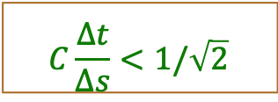
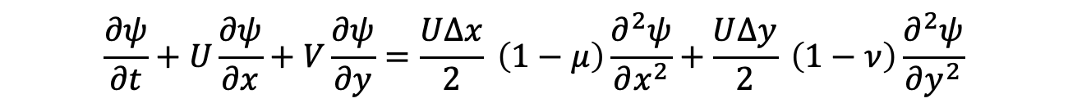
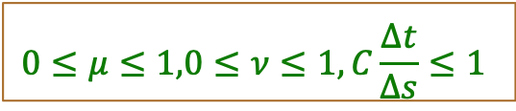
Lax-Wendroff-CTU Method
$$C\frac{∆t}{∆s}<1/\sqrt{2}$$
Forward-in-time and upstream scheme,
stability condition:
Corner Transport Upstream
(CTU) method
$$0≤μ≤1,0≤ν≤1, C\frac{∆t}{∆s}≤1$$
Truncation Error of CTU:
$$\frac{∂ψ}{∂t}+U\frac{∂ψ}{∂x}+V\frac{∂ψ}{∂y}=\frac{U∆x}{2} \left(1−μ\right)\frac{∂^{2}ψ}{∂x^{2}}+\frac{U∆y}{2} \left(1−ν\right)\frac{∂^{2}ψ}{∂y^{2}}$$
First-order of accuracy: $∆x$ and $∆y$, highly damping
Lax-Wendroff + CTU:
lessen damping + correct directionality
${ δ}_{t}φ^{j+\frac{1}{2}}+Uδ_{2x}φ^{j}+Vδ_{2y}φ^{j}=\frac{U^{2}∆t}{2}δ_{x}^{2}φ^{j}+\frac{V^{2}∆t}{2}δ_{y}^{2}φ^{j}+UV$ $∆t$ $δ_{2x}δ_{2y}φ^{j}$

Slide 12
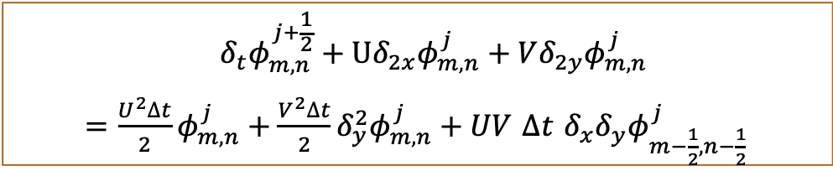

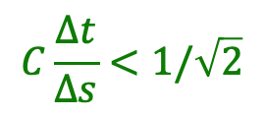
Lax-Wendroff-CTU Method
Lax-Wendroff + CTU:
lessen damping + correct directionality
${ δ}_{t}φ^{j+\frac{1}{2}}+Uδ_{2x}φ^{j}+Vδ_{2y}φ^{j}=\frac{U^{2}∆t}{2}δ_{x}^{2}φ^{j}+\frac{V^{2}∆t}{2}δ_{y}^{2}φ^{j}+UV$ $∆t$ $δ_{2x}δ_{2y}φ^{j}$
Necessary and sufficient stability condition:
$$C\frac{∆t}{∆s}<1/\sqrt{2}$$
Stability-improved:
$${ δ}_{t}φ_{m,n}^{j+\frac{1}{2}}+Uδ_{2x}φ_{m,n}^{j}+Vδ_{2y}φ_{m,n}^{j}$$
$=\frac{U^{2}∆t}{2}φ_{m,n}^{j}+\frac{V^{2}∆t}{2}δ_{y}^{2}φ_{m,n}^{j}+UV$ $∆t$ $δ_{x}δ_{y}φ_{m−\frac{1}{2},n−\frac{1}{2}}^{j}$
Necessary and sufficient stability condition:
$$0≤μ≤1,0≤ν≤1, C\frac{∆t}{∆s}≤1$$

Slide 13
Problem of 2-D Upstream Scheme

